Slide 1
Wave Function Collapse Algorithm
Procedural Game Content Generation Using the

Slide 2
PCG?
This can be the part of the presentation where you introduce yourself, write your email…

Slide 3
TABLE OF CONTENTS
01
02
03
04
05
06
THEORY
Explenation of how WFC works
IMPLEMENTATION
Simple Implemetation of the algorithm
RESULTS
An analysis of the algorithms output
MODIFICATIONS
Improvments and modification that can be made
COMPARISON
Comparison with other methods
CONCLUSIONS
Short summary and reevaluation

Slide 4
01
THEORY
Workings of WFC

Slide 5
THEORY
Wave Function Collapse algorithm is a greedy PCG algorithm based on the concept of collapsing a wave function.
It works by proceduraly “collapsing” a tile to one pattern and updating other affected tiles’s patterns.

Slide 6
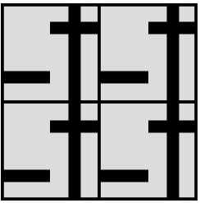
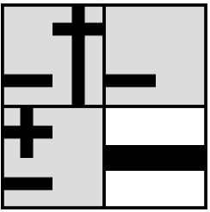
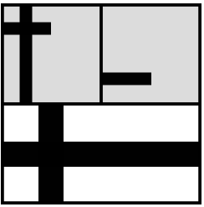
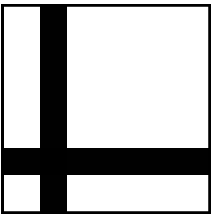
PROCESS
1
2
3
4
Initialize the super positions
Collapse a cell with the least entrophy
Repeat
Results

Slide 7
02
IMPLMENTATION
You can enter a subtitle here if you need it

Slide 8
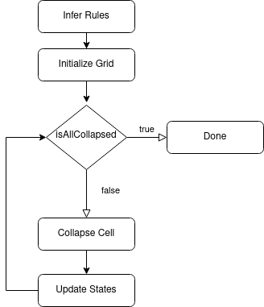
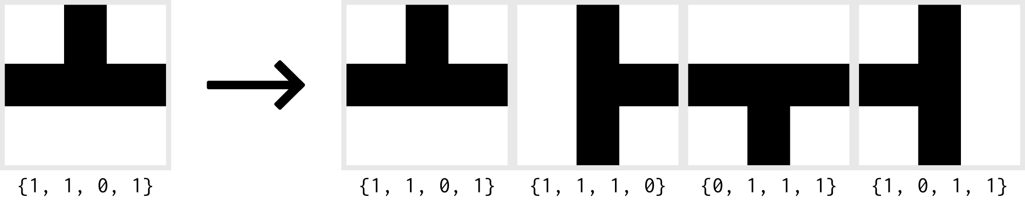
IMPLEMENTATION
The algorithm is very simple and straightforward
FEATURES A
SEMI-AUTO RULE SYSTEM
Tile relation configurations can be specified with only 4 numbers

Slide 9
03
RESULTS

Slide 10
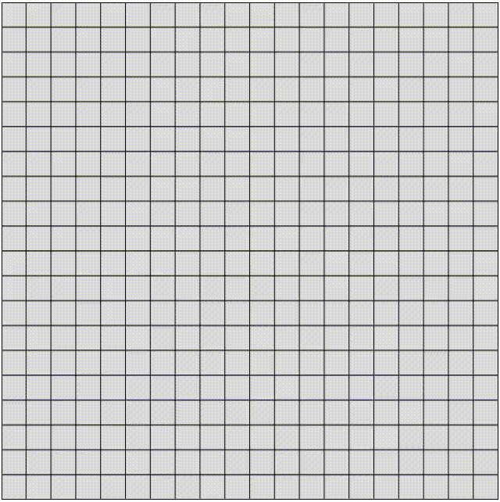

ROAD
Input:
Output:

Slide 11
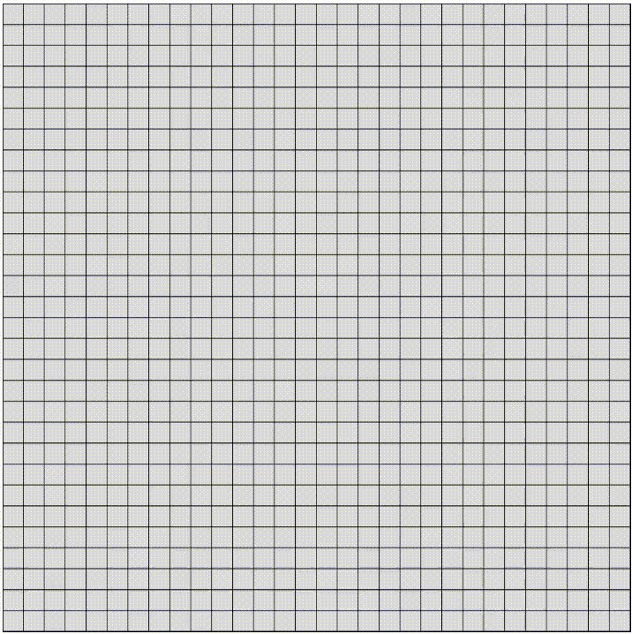
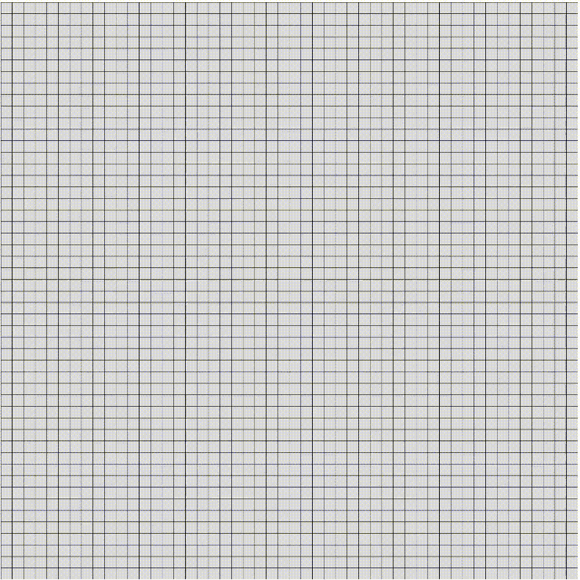
CIRCUIT BOARD
30x30
50x50

Slide 12
04
MODIFICATIONS
or Improvments

Slide 13
MODIFICATIONS
WEIGHTED COLLAPSE
AUGMENT WITH GROWING GRID
Assign a weight to each possible state
???
GENETIC SEARCH
IMPROVE CONTROL
Generate levels targeting specific play experience
More constraints making the output seem more Human-Designed

Slide 14
05
COMPARISON

Slide 15
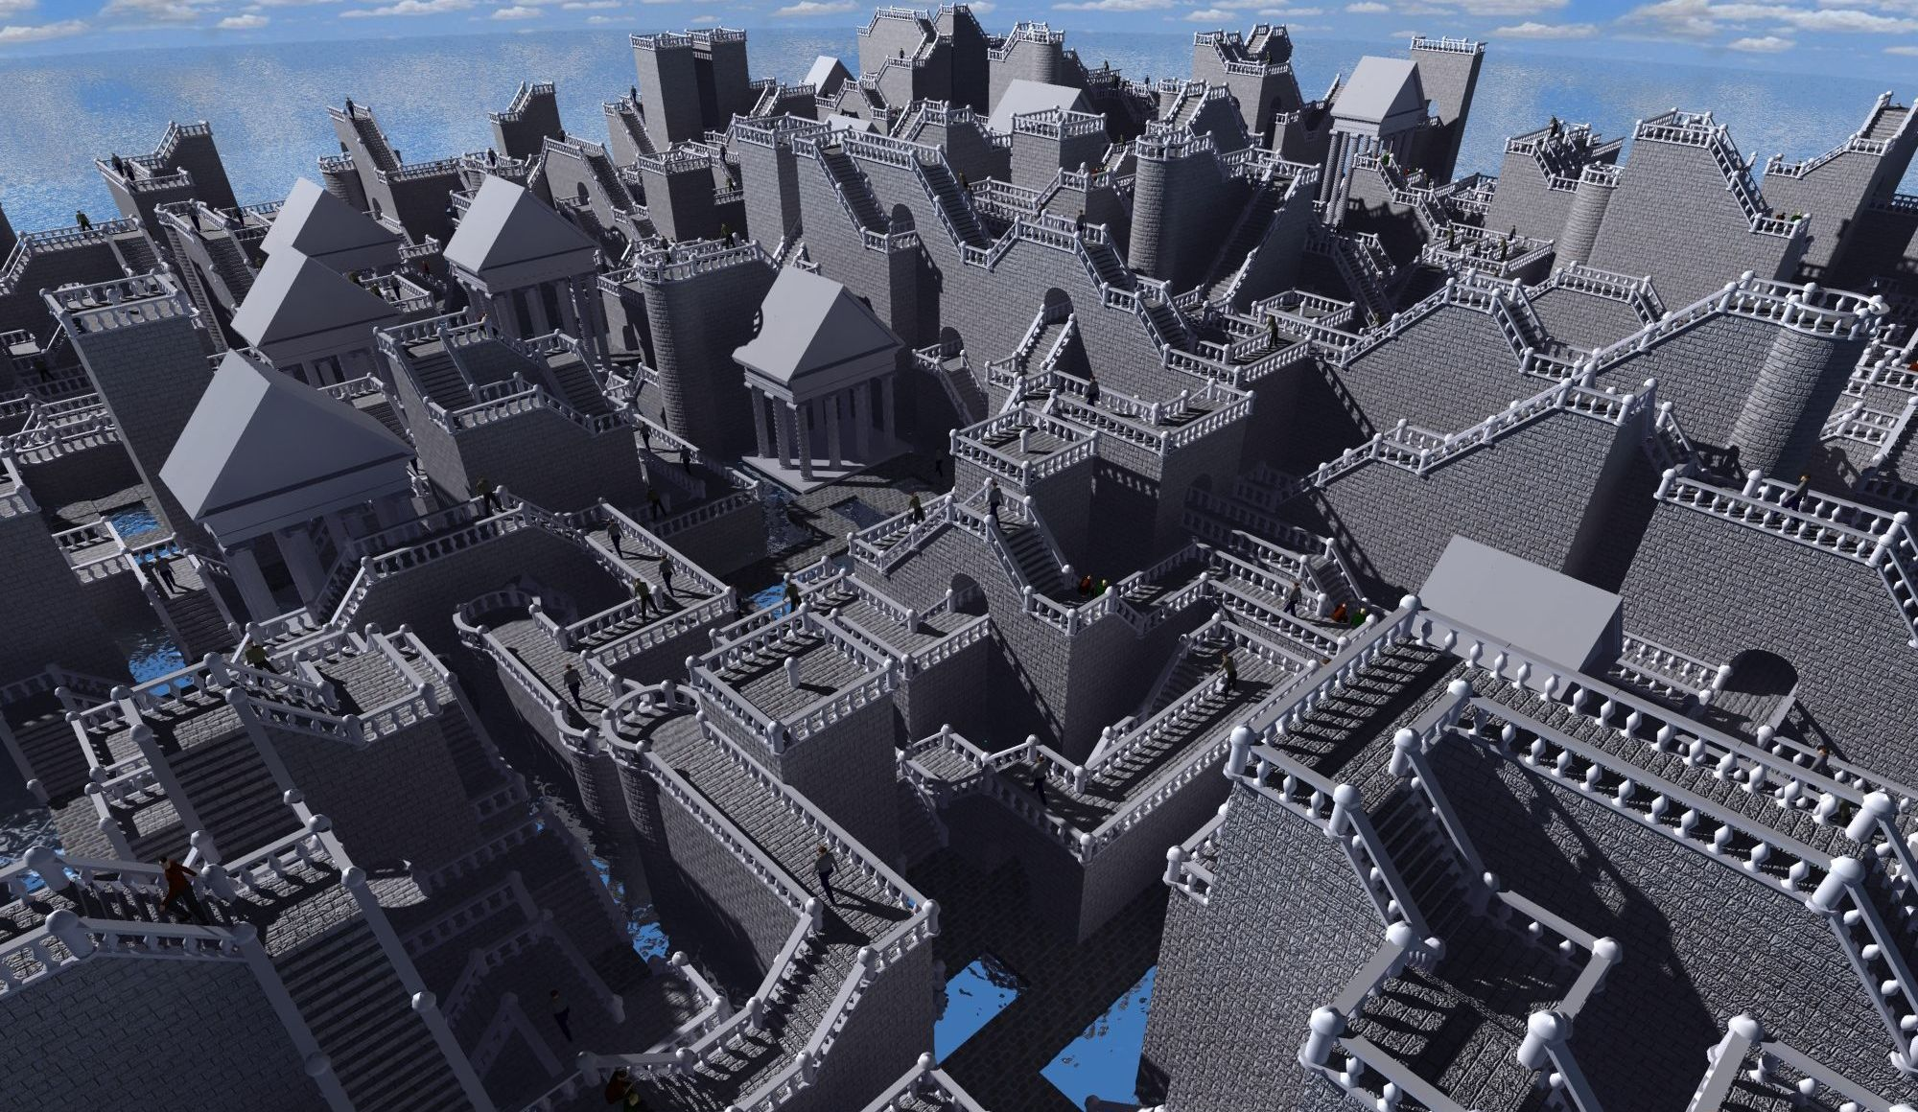
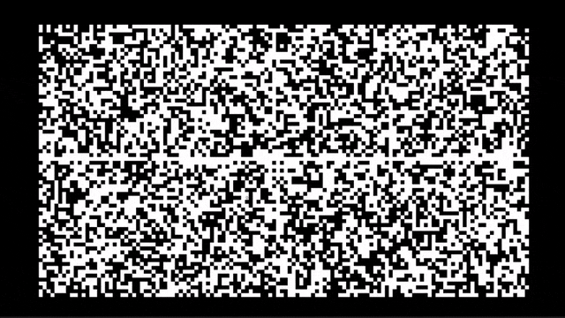
OTHER PCR ALGORITHMS
Model Synthesis
Cellular Automata

Slide 16
COMPARISON TABLE
 | WFC | MODEL SYNTHESIS | CELLULAR AUTOMATA
SPEED | Marginal | Marginal | Very Fast
CONTROL
 | Great | Great | Mediocre
DETERMINISM
 | Great | Great | Mediocre

Slide 17
CONCLUSION?
Why WFC?

Slide 18
THANK YOU!

Slide 19
RESOURCES
My Paper - Wave-Function-Collapse-Arcticle - https://github.com/Manthee1/Wave-Function-Collapse-Article

